Slide 1
Clustering Analysis of Obsidian from South American Volcanoes
By:
Francesca Lingo Jatin Jain

Slide 2
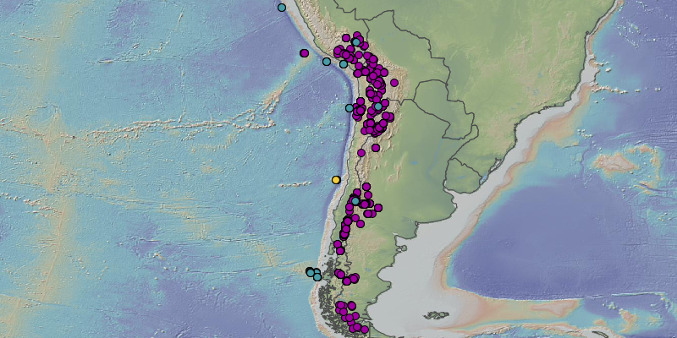
Background: Volcanoes and Chemistry
The Nazca Plate is an active oceanic tectonic plate that is subducting the South American Plate
→ Chain of volcanoes off/on Western South America
Cultures use volcanic rocks (obsidian)
Question: Using obsidian samples from these regions, can we distinguish their volcanic origins?
Anthropology: Insight into cultures and where they obtain these samples
Geology: Insight into mantle dynamics and differences in volcanic geochemistry
Notes:
Setting the scene
This should be the first and foremost target. What is the problem you are addressing in your research? And why is it timely, relevant and interesting? Why does it matter?

Slide 3
Hypothesis: Using Obsidian Samples to Predict Location
Using the geochemistry of obsidian samples found along western South American
Clustering by location ( long/lat)
Although this area’s geologic activity is similar, we should be able to find differences (?)
Notes:
Focus on your hypothesis/solution for your setting. Soon following the setting, you can get your audience to focus on your hypothesis/solution for the problem you are addressing.

Slide 4
Methodology
Clustering: by chemistry, no location and rock name (dacite, rhyodacite, rhyolite)
Unsupervised Learning:
Look at factors used to differentiate clusters
Supervised Learning:
Predict where new samples would belong
Notes:
Methodology/approach/work done. Now you explain your work towards achieving what you claimed in the previous step. Make sure to be concise. Nobody likes math formulas or deep technical details. Also avoid the urge the show-off your math or coding skills during this step. Simply present the steps you have taken on a higher level. If anyone is interesting to dig deep into the technicalities, they will follow up later. Flow charts and graphics are highly effective in this step. Paragraphs of text is a mistake.

Slide 5
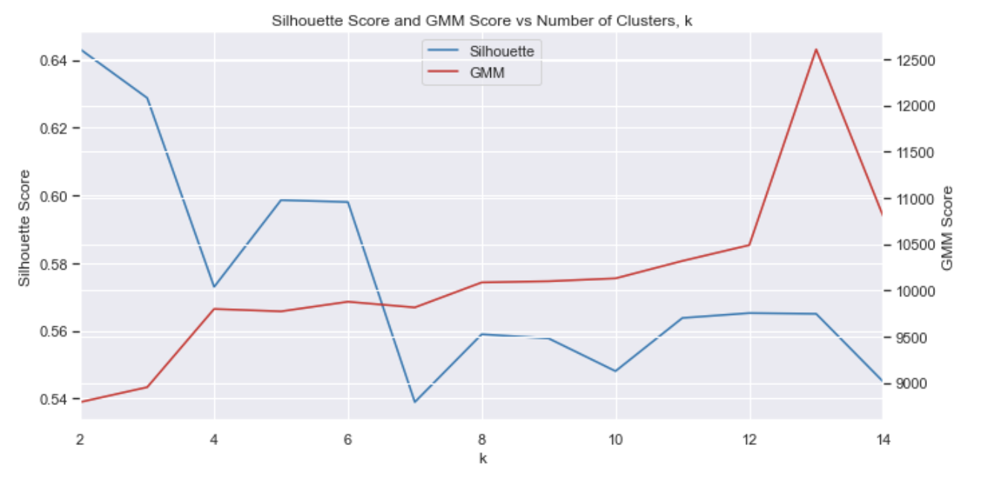
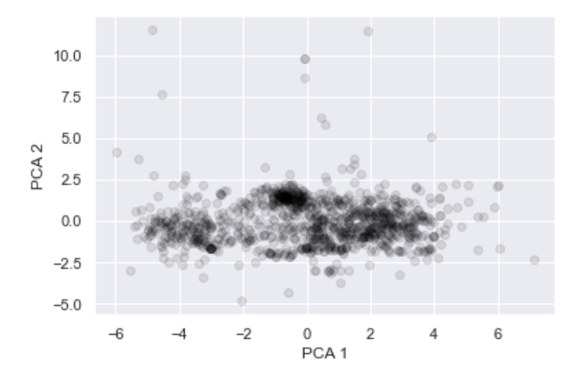
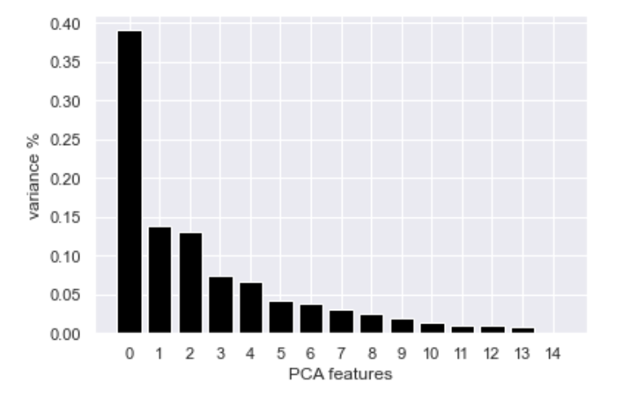
Results: PCA
Looking at the whole dataset, we see that there are a few principal components
Best k = 3
Comparing PCA 1 and PCA2 we see that there are no significant clusters
Data is pretty similar
Notes:
Contributions made and results. Highlight your impact. Show your outcomes and results of your applications. Point out the contributions you have made to the knowledge and understanding of the field. This is where you strengthen your stand in the solution you have proposed.

Slide 6
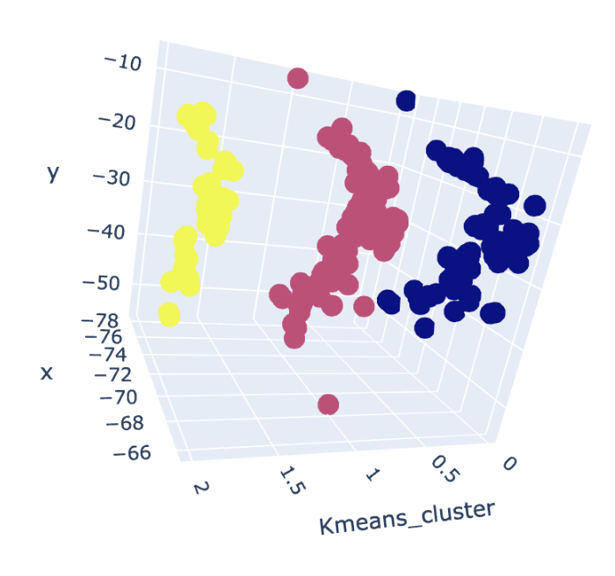
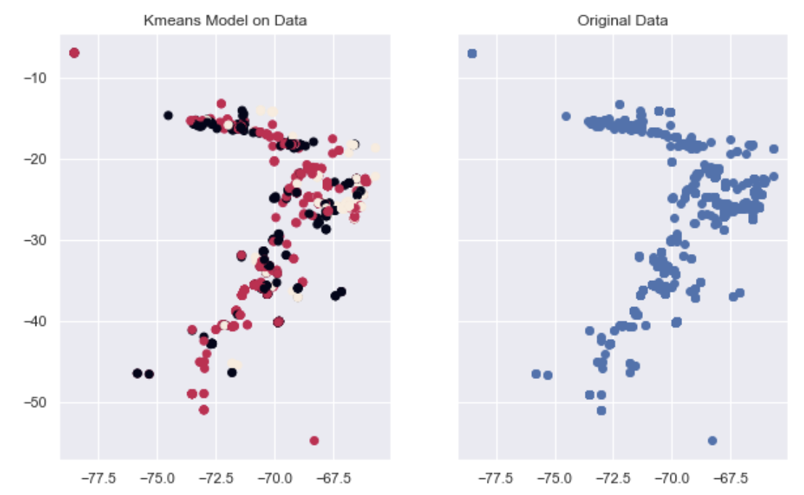
Results: Kmeans Model vs. Original Data
Total Explained Variance = 100%

Slide 7
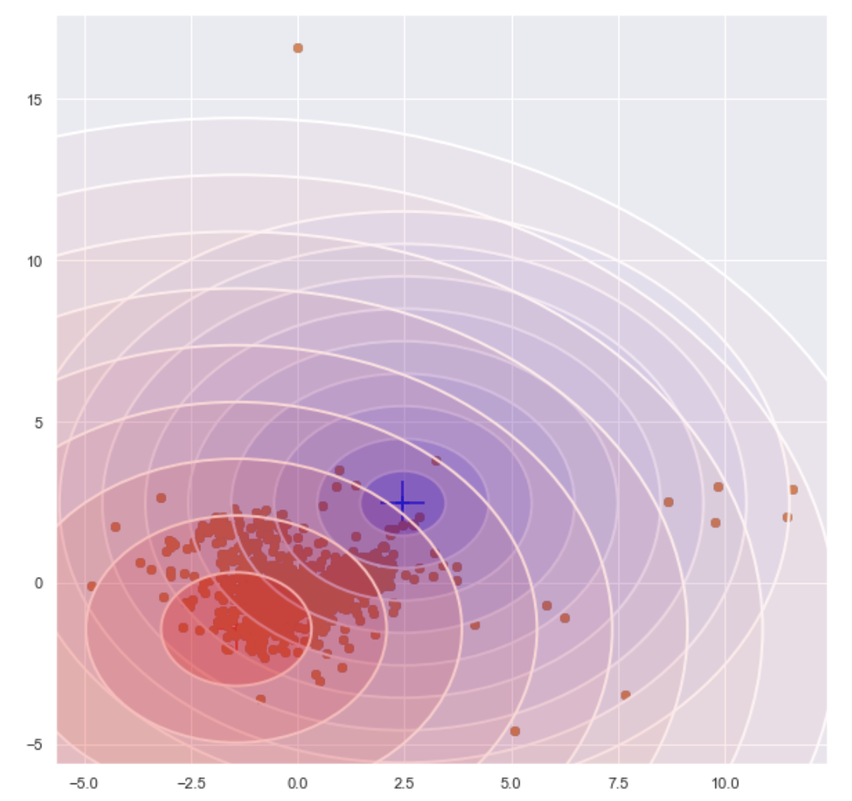
Results: GMM - FeO vs. TiO2
Magmatic Fe-Ti oxide are commonly associated mafic intrusions ( more than one source)
Most samples are Isolated and not linear suggested a single mantle source

Slide 8
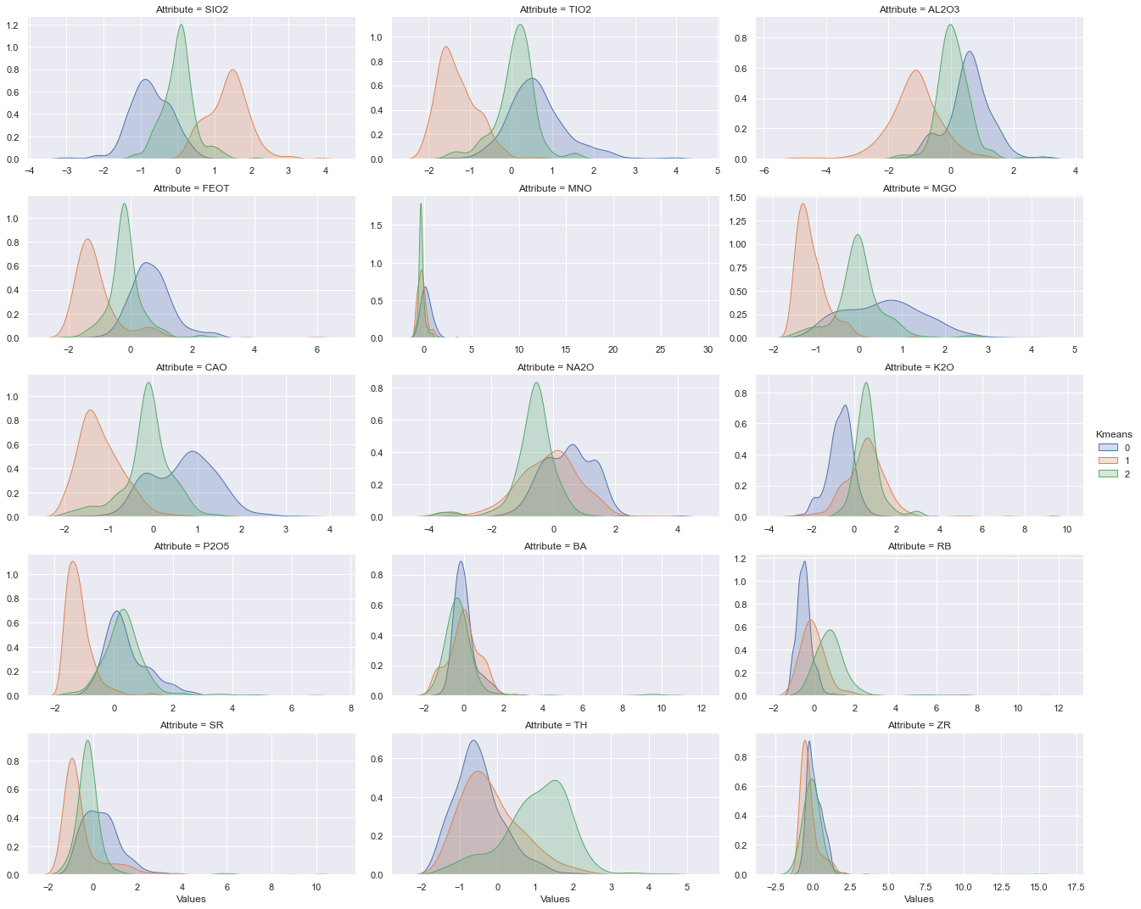
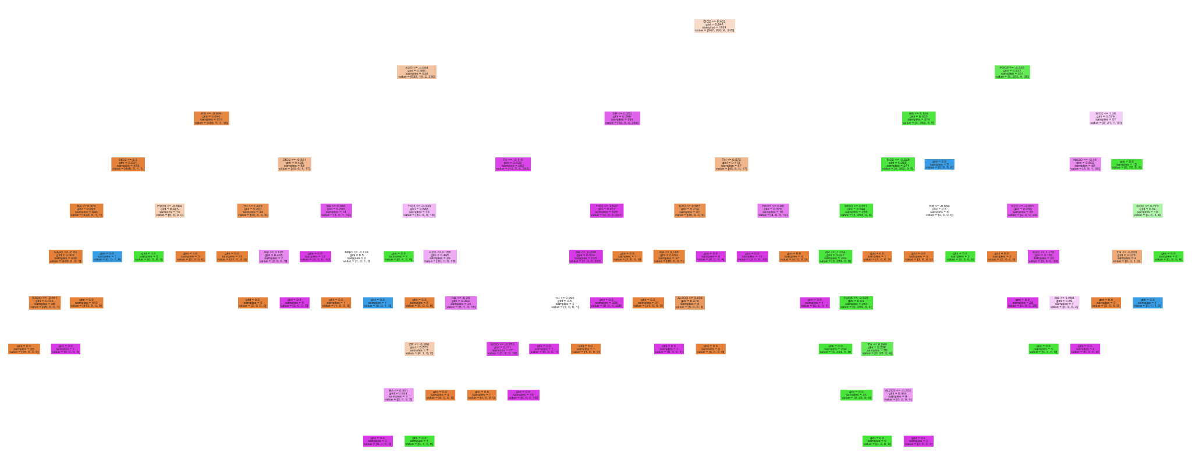
Results: Conditional relationships with Clusters + Decision Tree
LeaveOneOut Cross Validation: 97.3%
We are able to make a decision tree given geochemical attributes
Looking at the conditional relationships, we can better see how the clusters overlap each other

Slide 9
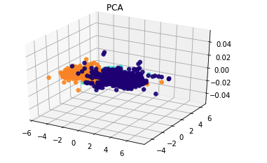
Results of PCA in 3D based on Sub Rock Type
Implemented PCA to do dimensional reductionality and to find samples of clusters with similarity based on their chemical properties and Rock Name
In this diagram we can find clusters overlapping each other, so the next thing to do was to rotate the graph or view it from a different perspective.

Slide 10
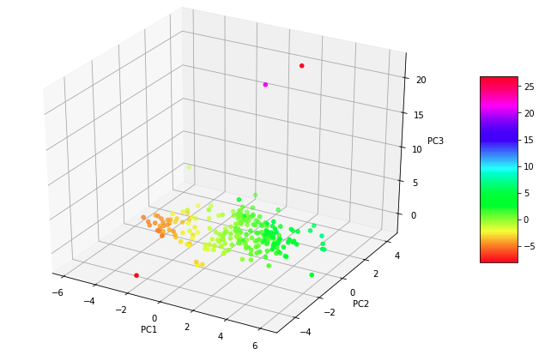
After viewing from a different view/perspective:
Conclusion : Not distinguishable

Slide 11
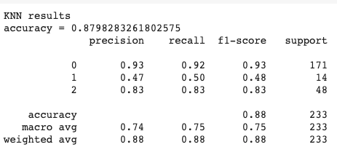
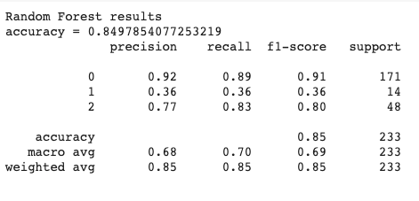
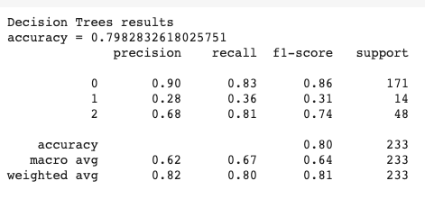
Classification
Used various Classification Algorithms such as KNN, Random forest and Decision tree in order to understand the obsidians. KNN Random Forest Decision Tree

Slide 12
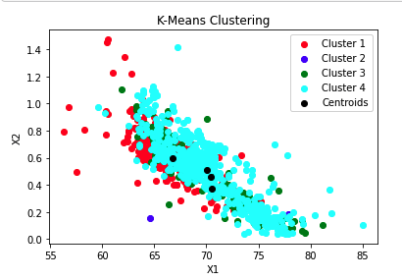

Clustering
K - Means
Overlapping Clusters
Not suboptimal

Slide 13
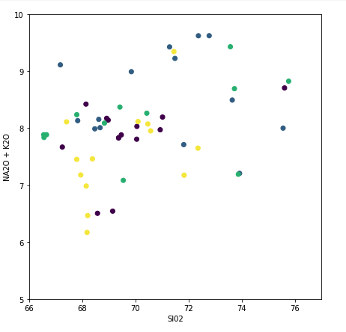
DBSCAN
Based on TAS Diagrams

Slide 14
CONCLUSION
With data given, we can not cluster geochemistry by location
Using Kmeans, we were able to find 3 geochemical clusters can be found along Western South America
Possibly one mantle source

